Slide 1
GRUPO ESCOLAR GETÚLIO VARGAS INGLÊS GLAUBER GUIMARÃES FERREIRA JOÃO LUCAS ROCHA TRINDADE JOÃO VICTOR SANTANA COELHO MATHEUS BATISTA QUEIROZ DE MEDEIROS ARAÚJO 8º ANO A TRASH DESTINATION Atividade solicitada como parte dos requisitos avaliativos da IV UNIDADE sob a orientação do professor VALTEONES DA SILVA RIOS. Mairi Outubro de 2017

Slide 2
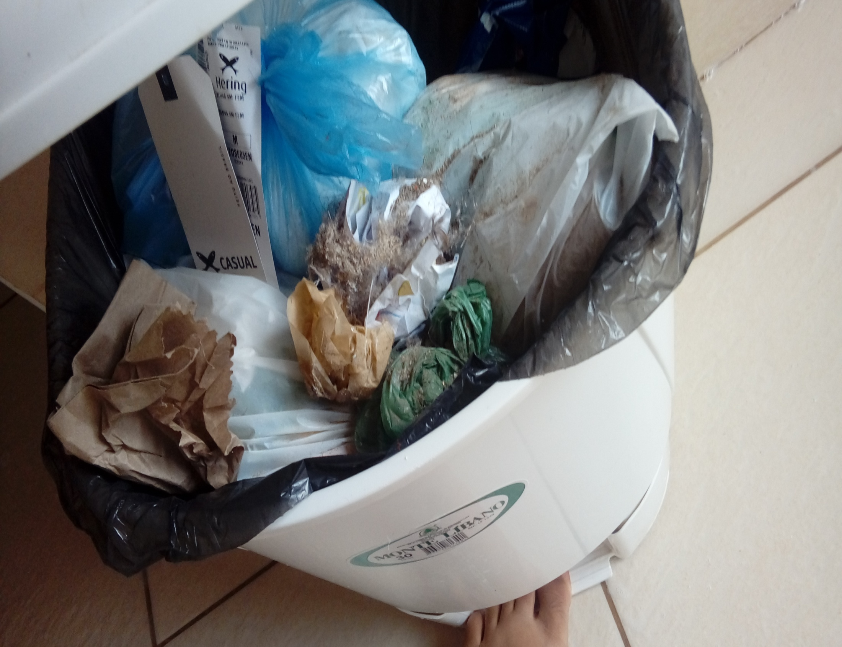
Matheus's garbage goes to the slab of the manhole, and then the garbage truck passes by and takes it.

Slide 3
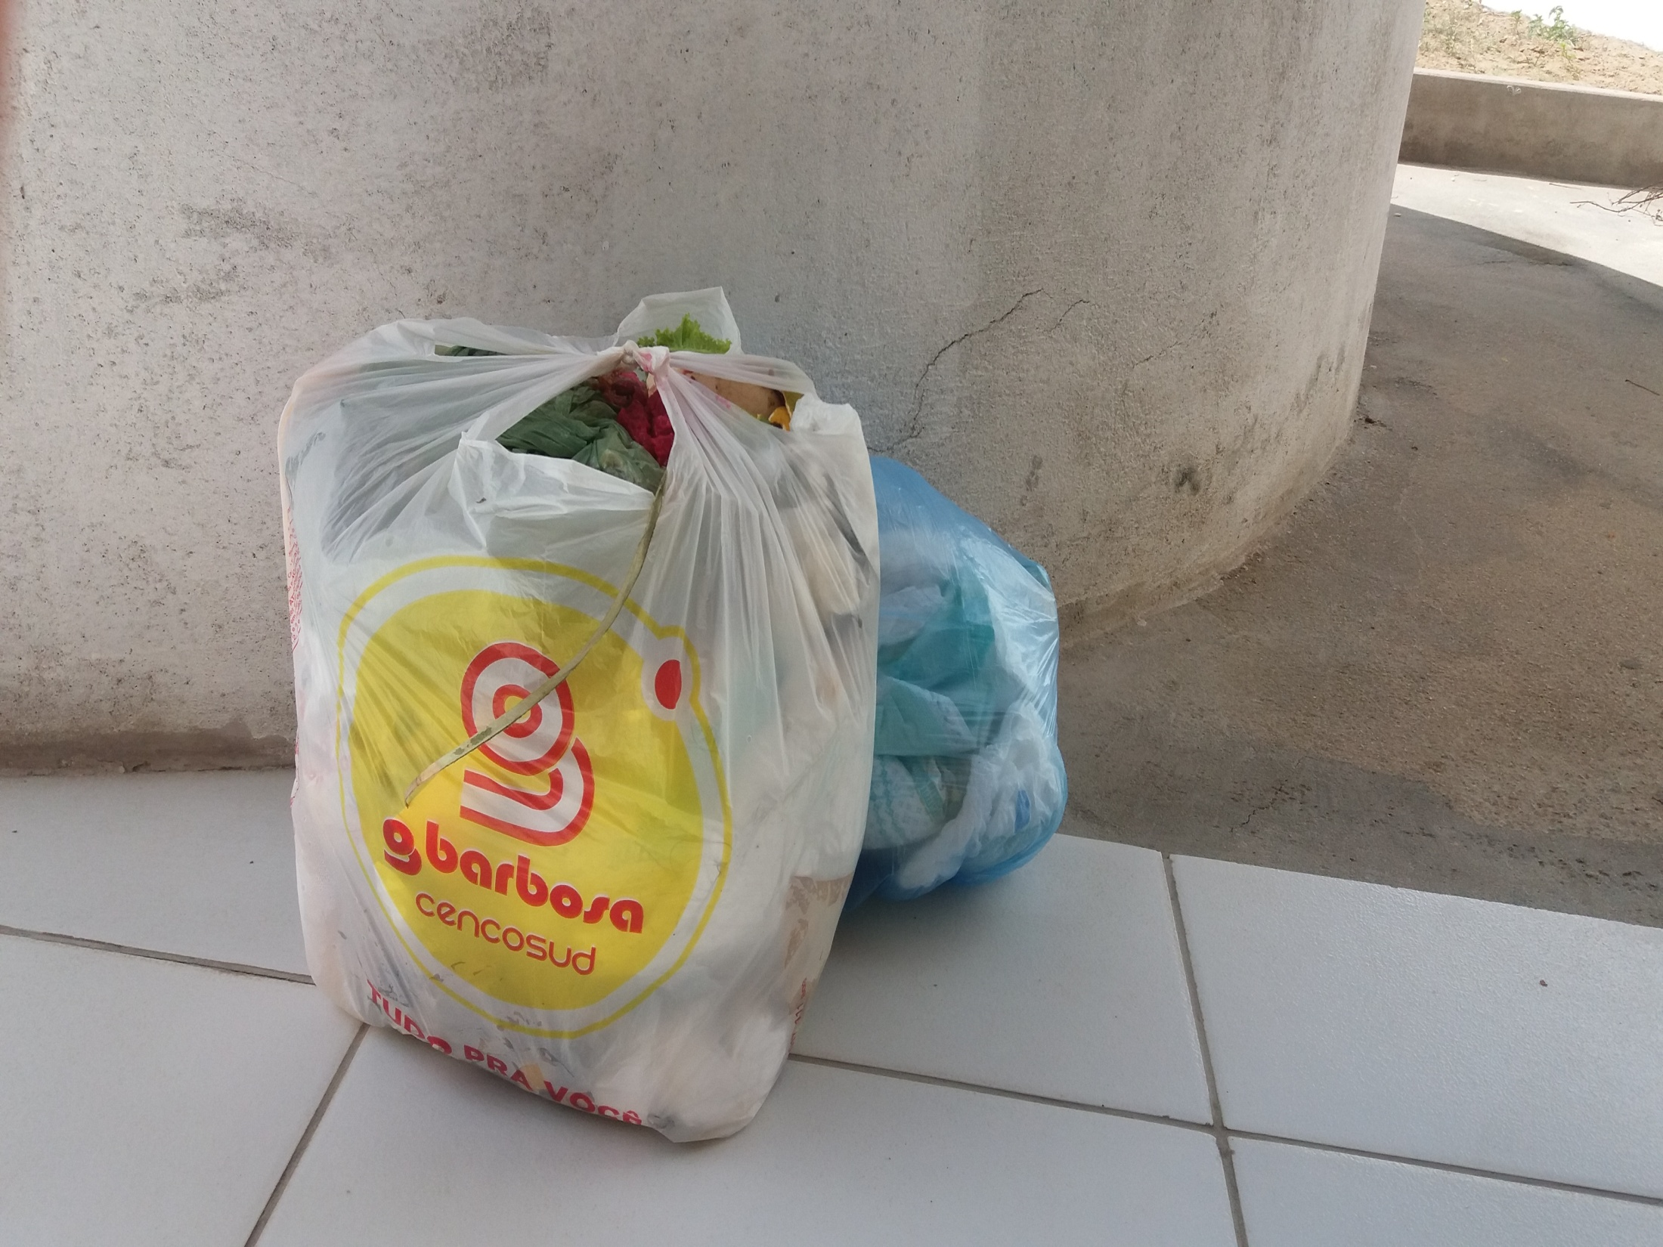
Glauber’s other discarded materials are placed in front of the house to be collected by the garbage truck.

Slide 4
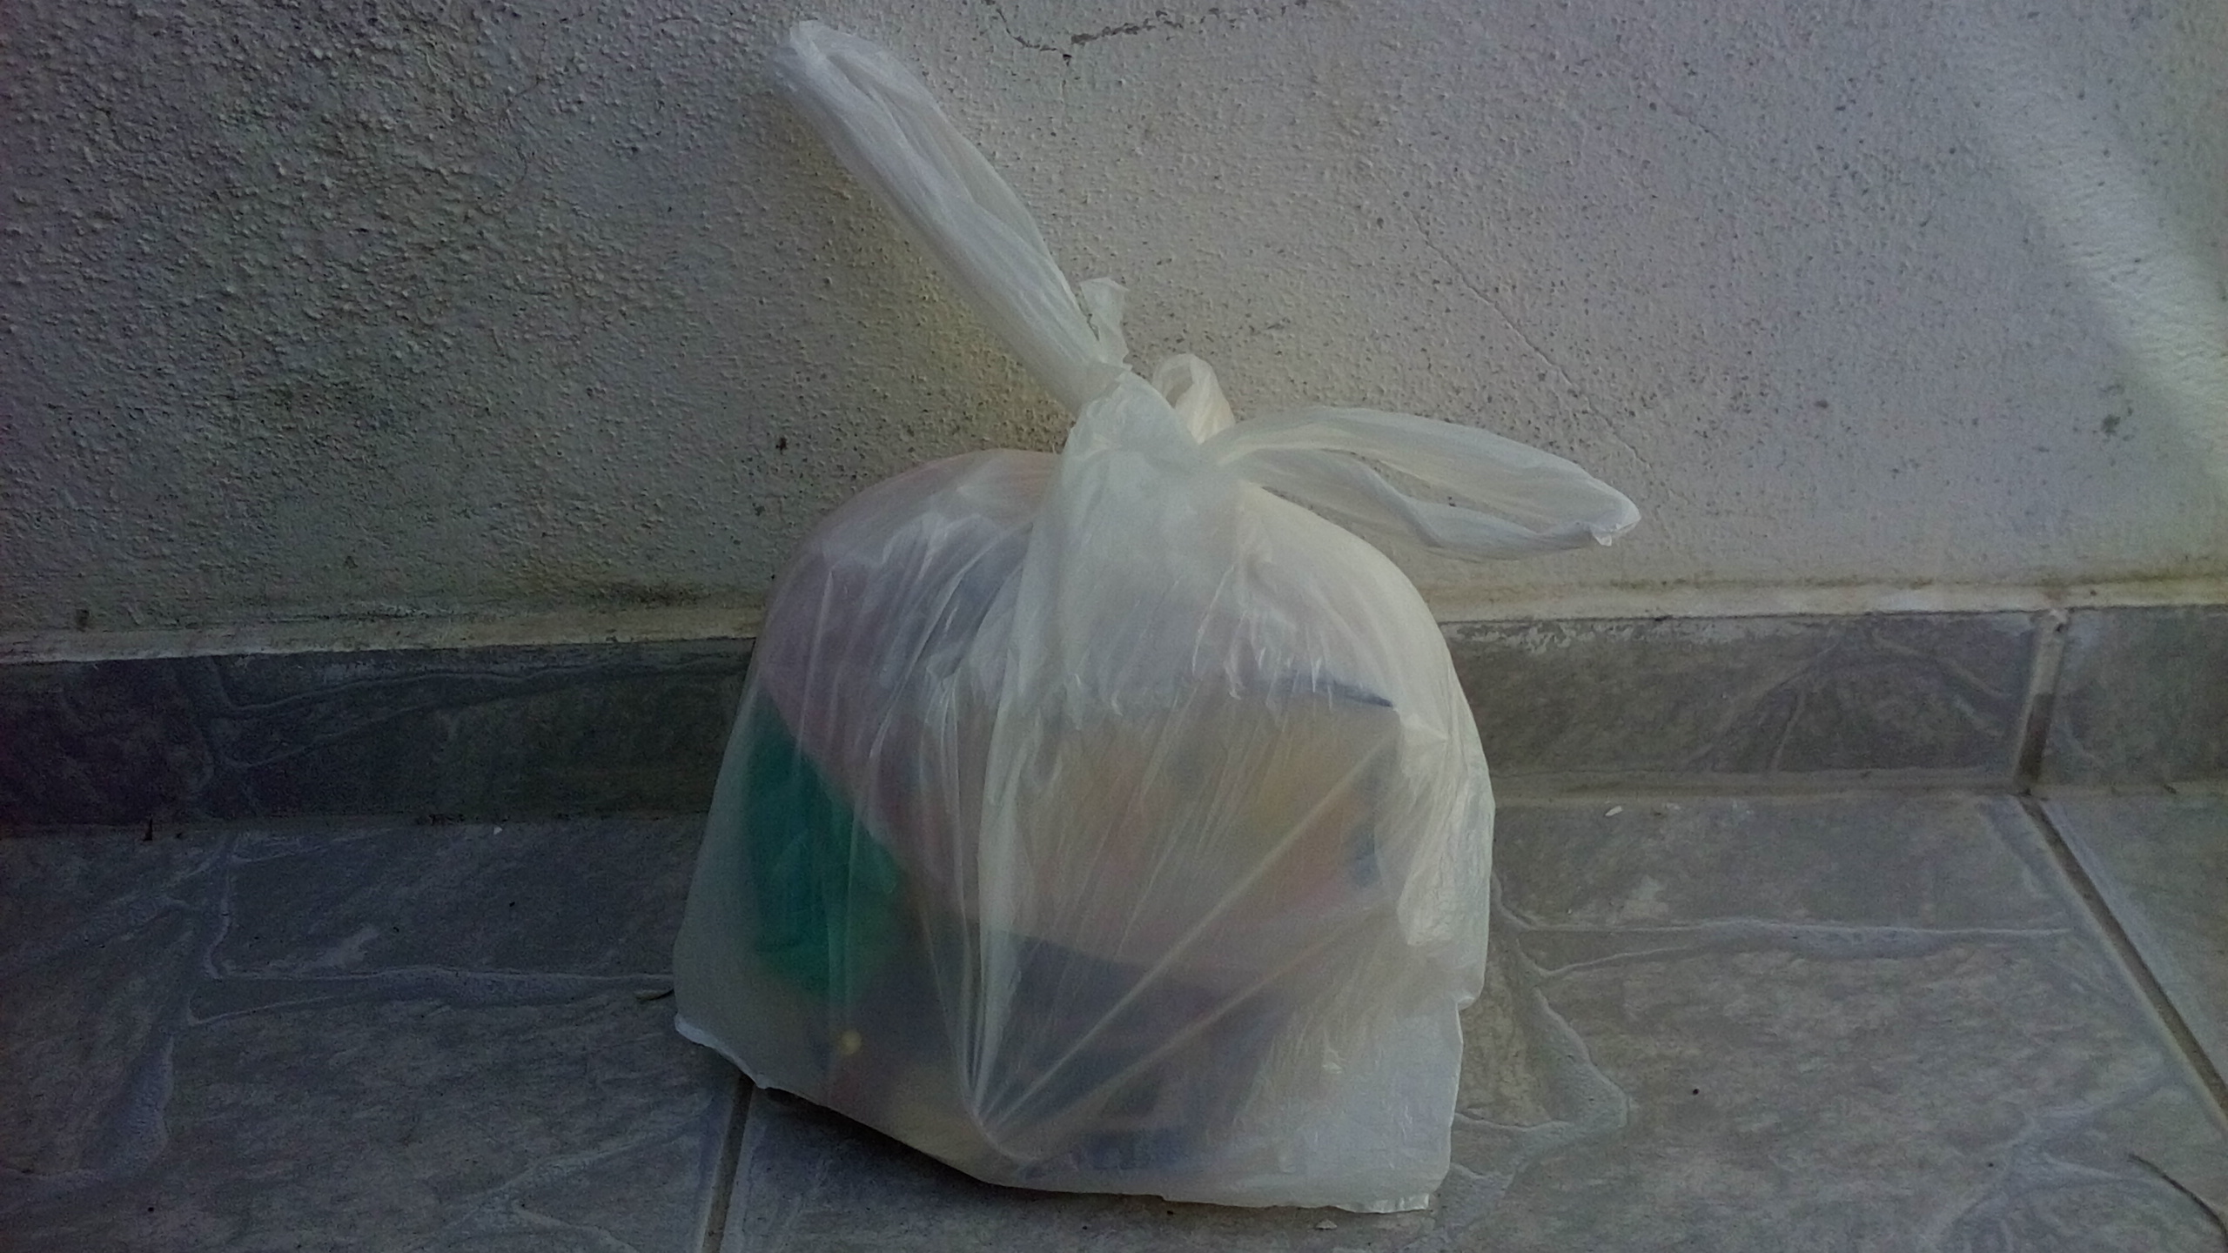
The garbage of João Lucas’s is separated into two parts. This part goes to the dump.

Slide 5
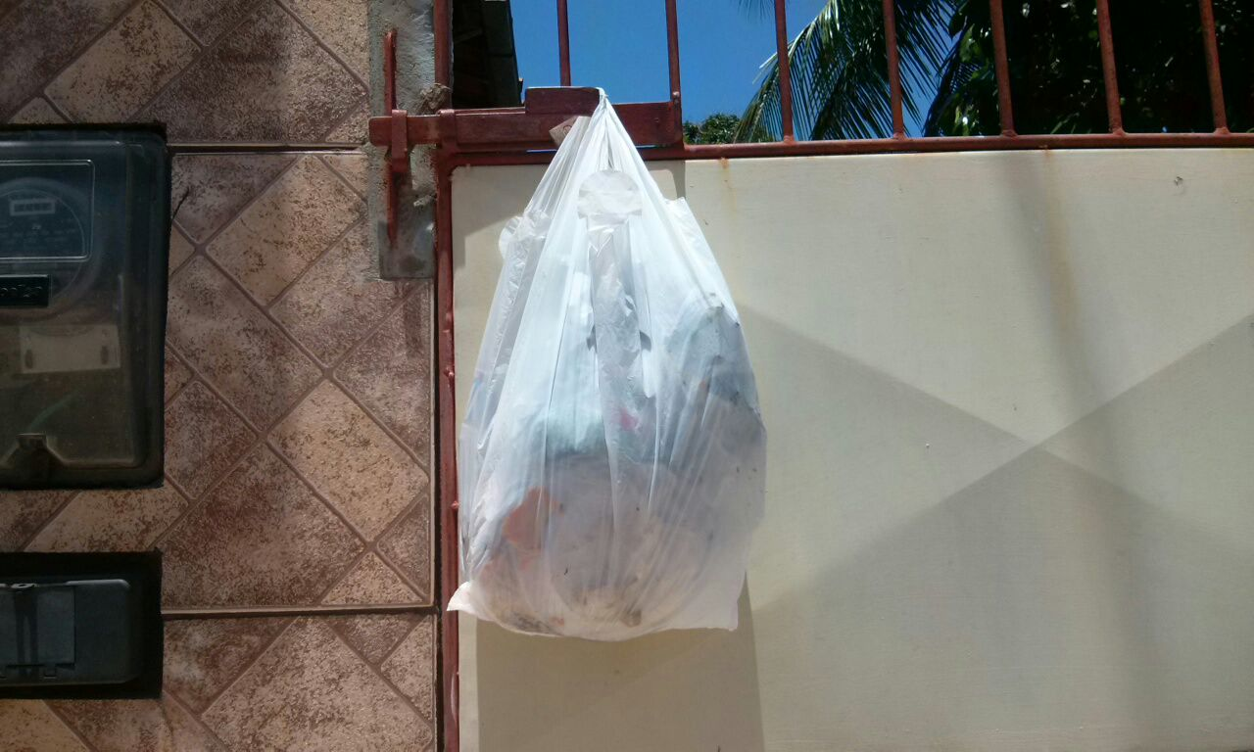
João Victor's trash is separated into only two parts, pet bottles and ordinary trash.

Slide 6
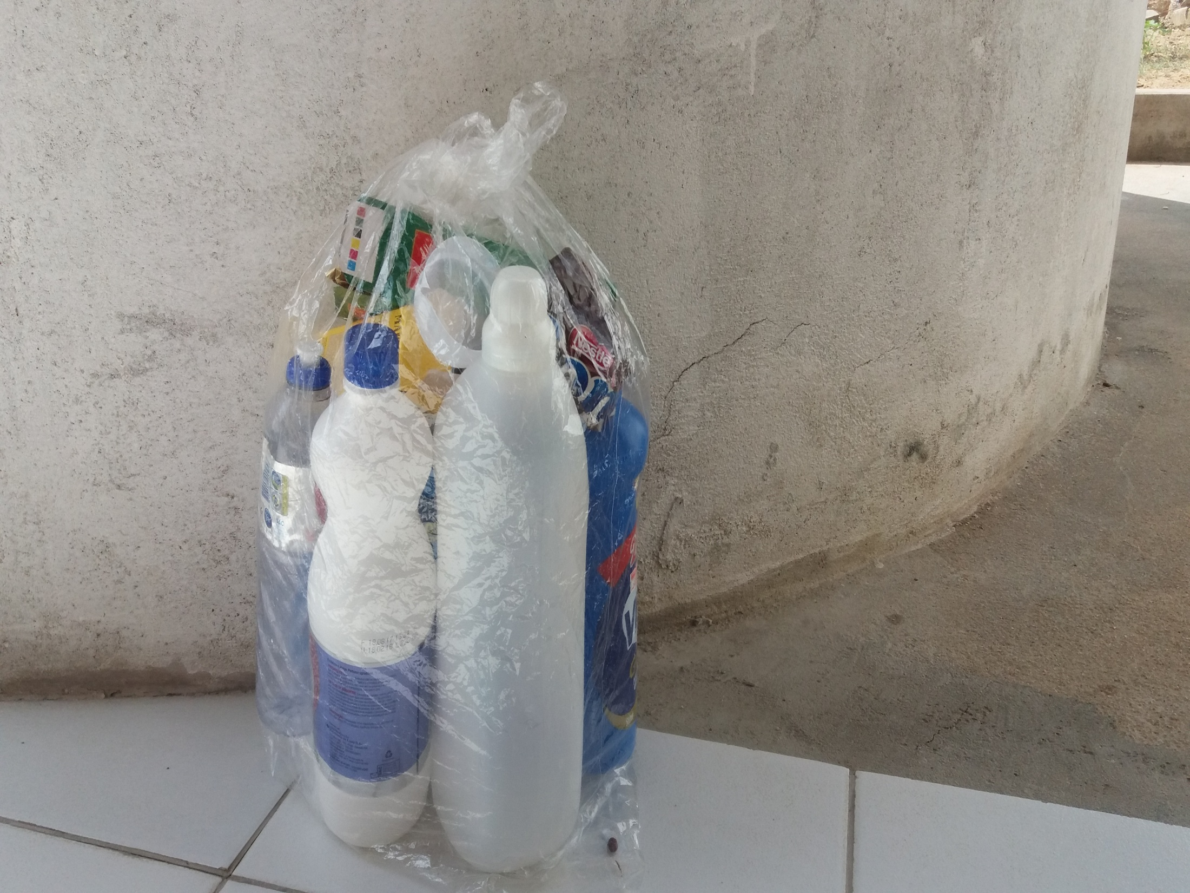
The trash from Glauber's house is separated from the plastic and paper for recycling.

Slide 7
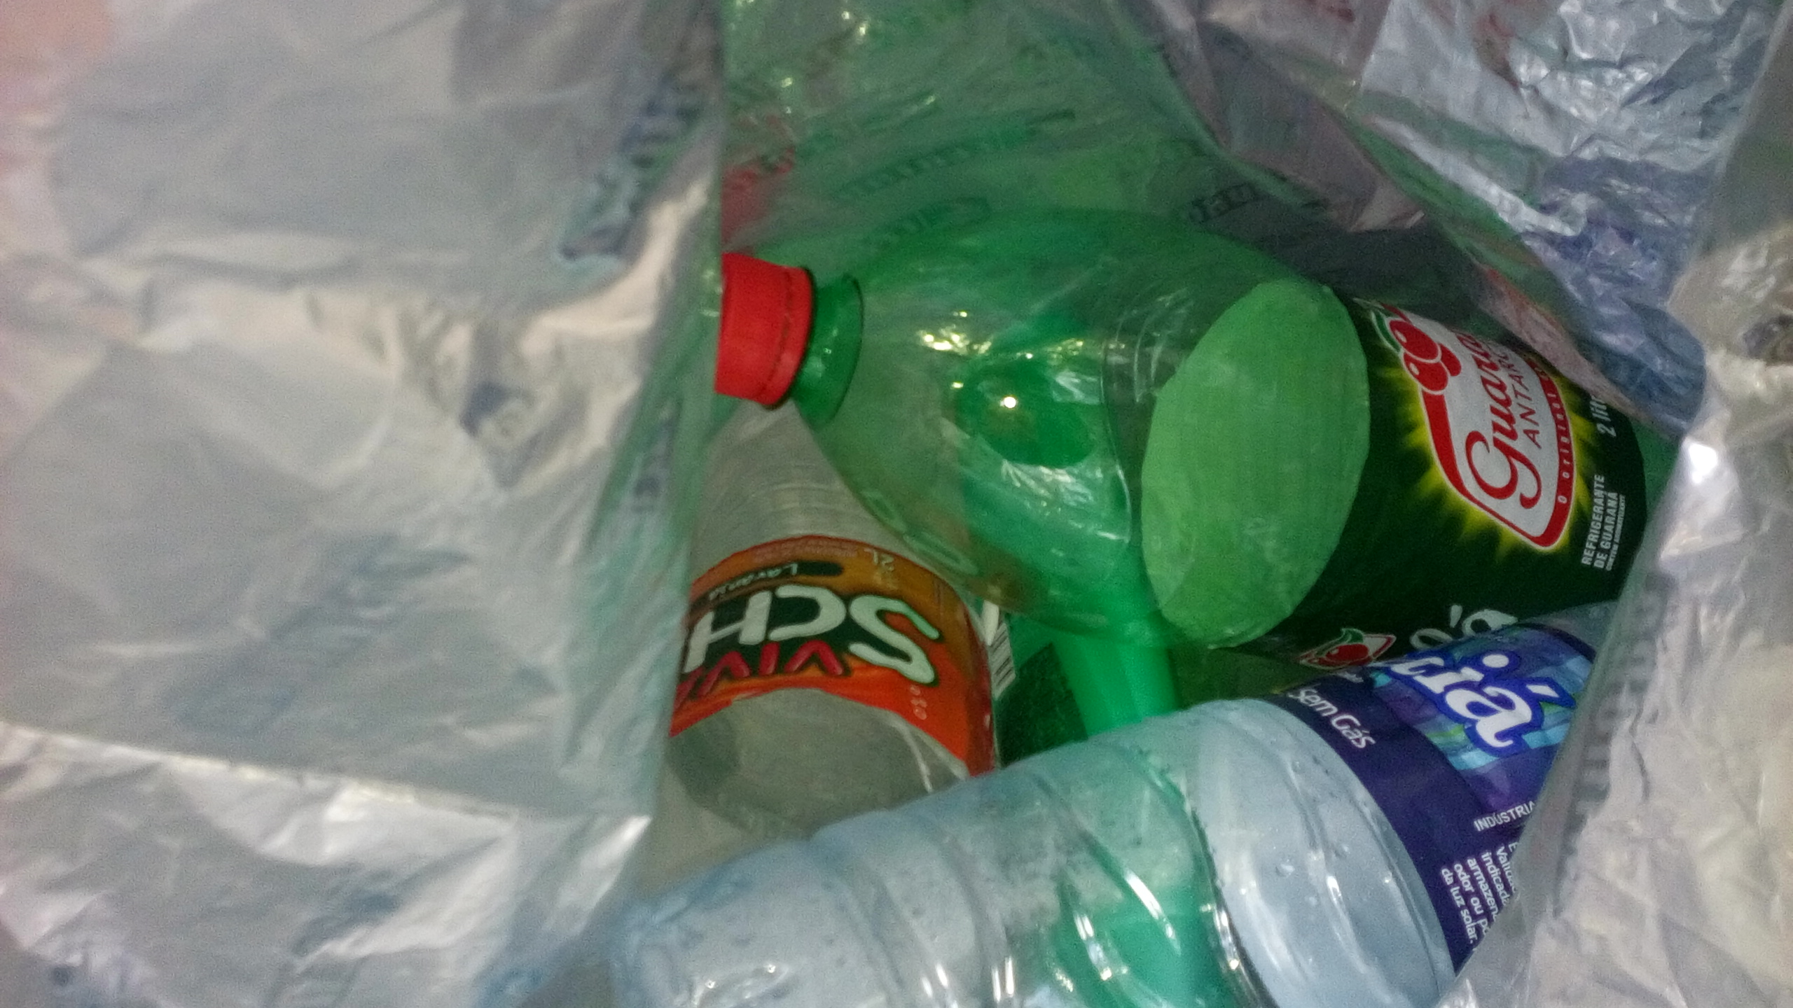
This part of João Lucas's trash goes to the parish hall, which goes to recycling

Slide 8
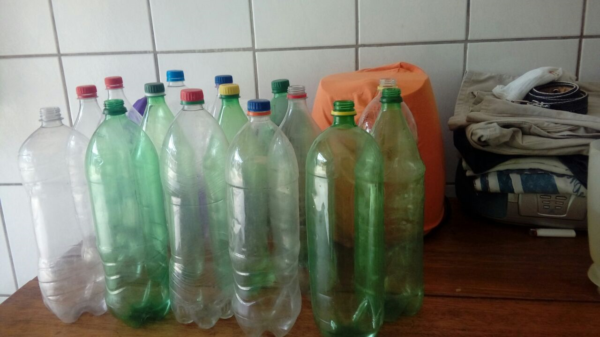
This piece of junk from João Victor goes to recycling

Slide 9
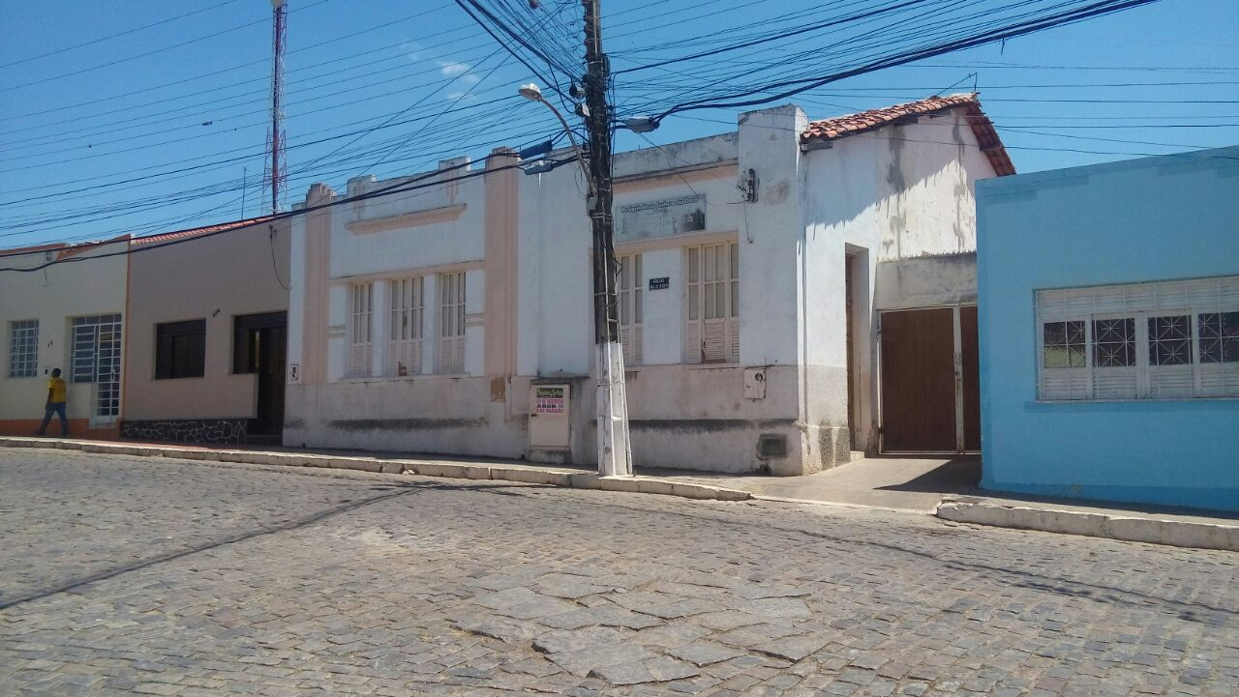
The plastic and paper separated to recycling are taken to the parish hall. So they are sold.

Slide 10
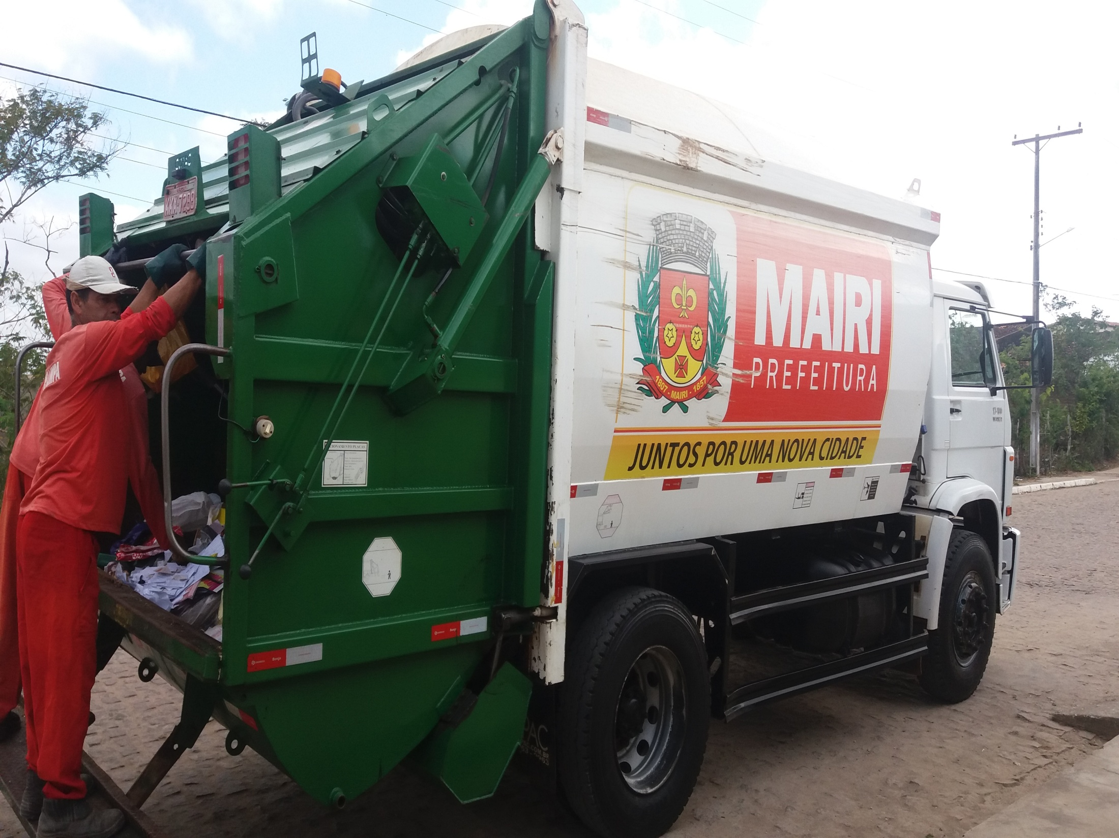
All the garbage placed in front of the houses are collected by the truck.

Slide 11
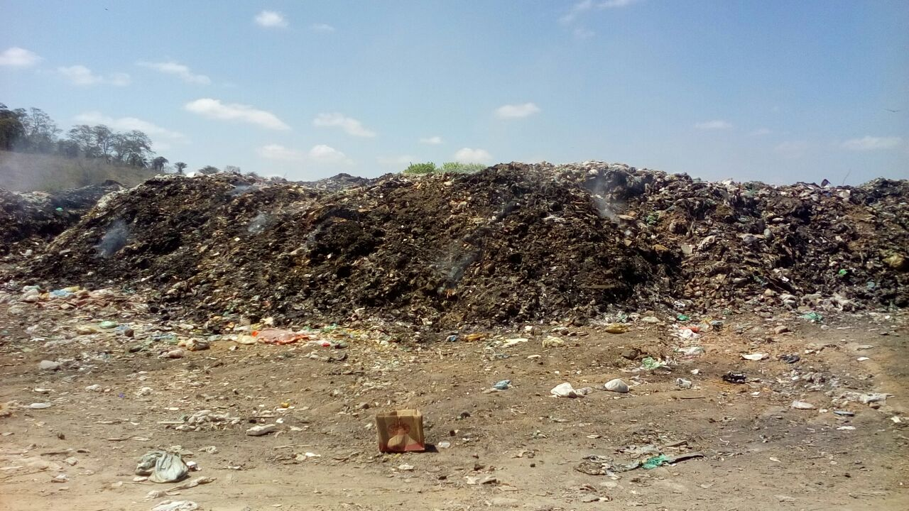
The final destination of the garbage collected by the truck is the landfill.

